Slide 1
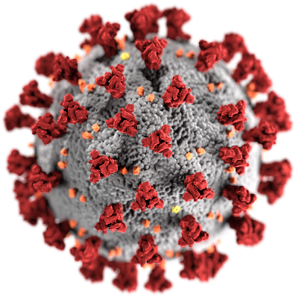
Πρωτοβουλίες Ψηφιακής Καινοτομίας ενάντια στον Κορονοϊό
Διαγωνισμός Ανάδειξης Καινοτόμων Ιδεών - #COVIDhackGR
Platform for Remote and Personalized Prevention and Therapeutic Care on COVID-19 using Artificial Intelligence Methods

Slide 2

The PROBLEM
General population has a risk of being infected and then spreading COVID-19
There is a limited capacity for COVID-19 testing
Limited capacity for healthcare professionals to review all COVID19 suspected cases.
Lack of details on the location of COVID-19 suspect and positive patients
Screening patients in-person and in hospitals creates a safety risk and further spreads the infection.
Rush and panic amongst the population if they have any symptoms or have been exposed to someone who has tested positive for COVID-19

Slide 3


Our Solution
Telehealth Platform
Machine Learning & Visualization Tools
Telehealth Care
Risk Infection
Severity Estimation

Slide 4
Pillar A – Tele-healthcare
Rapidly deploy within 1 week - cloud-based solution to provide an end-to-end workflow
Provide the population with instant access to an online questionnaire that can effectively give them access to care.
Remotely screen and automatically triage patients via patient-reported responses
Easily conduct remote tele-consultations with symptomatic patients
Remotely manage self-quarantined patients through standardized Care Plans.
Track them regularly for change in symptoms to escalate priority
Refer patients to clinical facilities based on the severity of their symptoms.
Eliminate lack of education via customized text, documents and video messages

Slide 5


Enable your clinical teams to do more!
Manage large incoming patient requests using automatic triaging of symptoms.
Clinical providers focus only on patients that are symptomatic with high risks.
Patients with low-risk or common flu symptoms can be remotely tracked with daily questionnaires.
If and when they present high-risk symptoms is the Care manager informed to review their case.
Provide more bandwidth to clinical staff to deal with the high volume of COVID19 suspected cases.
Track geo-locations of patients to assess where resources are needed.
Configure triaging logic as guidelines evolve.

Slide 6
Rapid Deployment
Web based app accessible on all internet devices (PCs, laptops, mobile devices and tablets) + Native iOS and Android apps
Online link to a Screening Questionnaire that can be embedded in websites or sent via text messages to patients
Patients fill up forms and are signed up automatically in the COVID-19 app
Can access telehealth appointments (Online video conferencing)
Automatically record GPS locations of patients
They get alerts and notifications if they are put on Self-quarantine plan and can report vitals such as Body temperature, symptoms, etc.
Report ongoing change in symptoms for automatic triaging
Web-based portal for a centralized Care Managers
Automatically triage patients based on the COVID19 screening logic
Receive patient responses that are high risk for intervention as tasks
Schedule a telehealth visit using a web online video conference
Track patients on Self-quarantine plans and track them remotely
Escalate priority if they report new high-risk symptoms in quarantine
Or refer the patient to a hospital for in-person testing
Real-time tracking of patient vitals in self-quarantine or isolation

Slide 7
Automatic Triaging for COVID19 Cases
Fever + (Shortness of Breath OR Difficulty Breathing OR Tightening in the chest)
Fever + Dry Cough + (Running Nose OR Tiredness OR Sore Throat OR Body Ache)
Fever + (shortness of breath OR difficulty breathing OR tightening in the chest) + (history of cancer OR autoimmune diseases OR on Immunosuppressant drugs)
Fever + International Travel History
Been in contact with a COVID-19 Positive patient
Sends the patient credentials to login to the patient app.
Automatically assigns them to a Self-quarantine Care plan.
Daily questionnaires to check for change in symptoms.
Development of any high-risk symptoms will create a high-priority task for the Care Manager worklist.
Creates a high-priority task for the Care Manager worklist and sign-up the patient on the app.
They can review the patient details and set up a tele consult or recommend a Self-quarantine Care Plan

Slide 8
COVID-19 Solution Workflow
The patient accesses the link and responds to the questionnaire. Creating an user for the him/her and credentials are emailed.
Care Coordinator receives a task if the patient is symptomatic and reviews Questionnaire Responses
Assessment Questionnaire is sent to the Patients via a publicly accessible link or hosted on a website
START
Does the patient need further assessmentvia teleconsultation?
Care Coordinator reviews responses and completes the Task. Triggering an email notification to the patient- reporting not requiring further assessment
A Care coordinator books a teleconsultation appointment for the patient.
The patient gets an email notification for teleconsultation
END
NO
YES
Based on the severity of the condition, the doctor assigns one of the following care plans to the patient
Self-Quarantine
Patient checks the temperature daily
Daily Questionnaire to check for change in symptoms
Refer the patient to the hospital for an in-person assessment
The doctor determines which care plan to be assigned to the patient
The patient joins teleconsultation with the doctor. Doctor remotely assesses the patient and takes notes during the session.
END

Slide 9
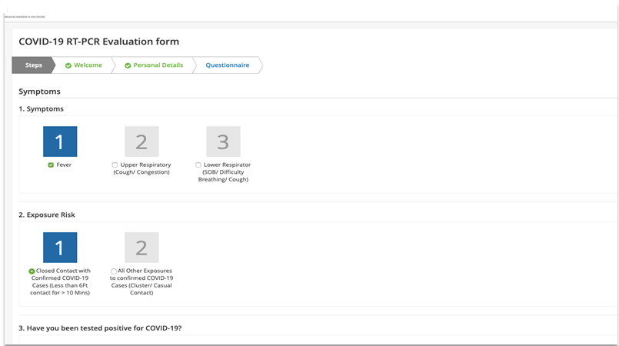
Patient Self-reports symptoms via Questionnaire

Slide 10
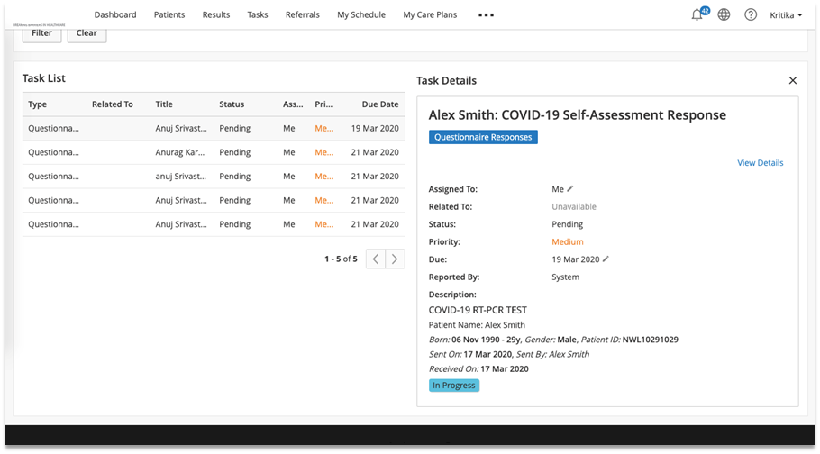
Care Coordinator gets tasks to review the Patient response only for High priority Triage cases

Slide 11
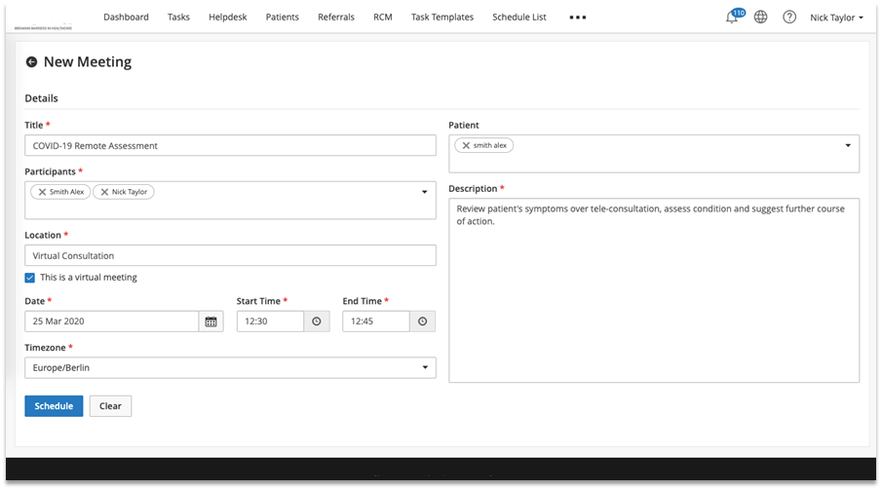
Care Coordinator books a teleconsultation session

Slide 12
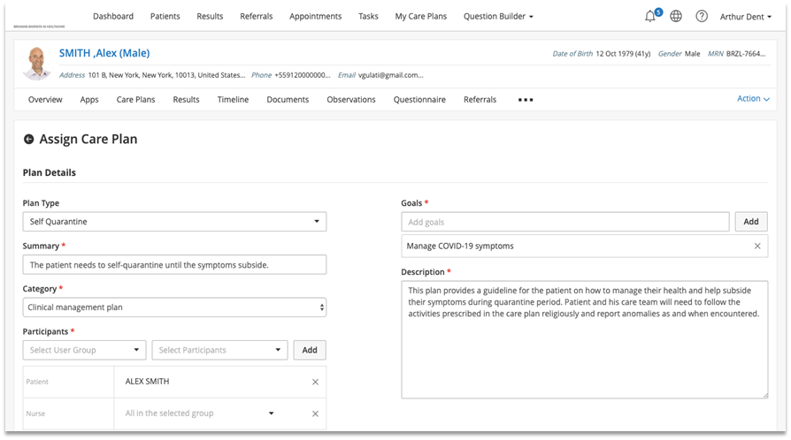
Doctor assigns the Care plan to the patient

Slide 13
Pillar B Estimation of the risk of infection
A mobile application for public (contacts) to self-regulate themselves and
Aims to advance the Triage and decision- making during epidemics with environmental and personal information automatically.
It helps diagnosticians to empower families and suspected infected contacts of the patient to combat the illness and stress, in no time.
It consists the first objective estimation tool of covid-19 that includes clinical aspects (underlined diseases, obesity, clinical symptoms), environmental aspects (environmental humidity, temperature, socioeconomic data, proximity details, previous occupational exposure to NPs, locality, etc) into diagnosis (NPHO guidelines, START, SOFA), estimates medically unexplained symptoms questionnaire (MUS), chronic stress and proximity (contacts -suspected infected).
By machine learning, focused and personalized options are given to the specialists to decide further targeted and personalized treatment of the patient.

Slide 14
Pillar B Estimation of the risk of infection
Risk
of infection
Pollution
Social distancing
Geography
Age
Local economic activity
Climate
Seasonality
Life style
Personality
Conformation to authorities
measurements
Underlined diseases
symptomatology
UNKNOWN
Chronic stress
Occupation
Factors to be considered

Slide 15
Pillar B Estimation of the risk of infection
Interact with family members and friends to provide a faster intervention
Digital activities aggregator: Capture mobile geolocation, web browsing, clinical info, climate info etc.
Communication module with external users
Family members and friends
Social activities identifier: Detect the existence of contacts using geolocation
Local
storage
e-Coacher: Empower and improve patient self-regulation skills to combat stress
Update models
module:
- Sync data with platform
- Dynamic update empowerment & diagnostic criteria
- Provide real interaction with NPHO & hospitals
User gives consent
PATIENT

Slide 16
Pillar B Estimation of the risk of infection
Risk Analysis and Mitigation Engine (RAME)
Dynamic re-estimation of the classification model and risk probabilities factors
API-based and permission-based communication with social media profiles and/ or 3rd party information systems capturing individual lifestyle data
2-way API-based and permission-based communication with mobile services
Interaction with MObile Risk analySis and managemEnt service (MORSE)
Development based on open data principles to support communication with 3rd party mobile apps related with COVID-19 data analytics
MObile Risk analySis and managemEnt service (MORSE)
Mobile app that tracks: (a) the daily routes, (b) habits of individuals, (c) work and leisure interactions
Provides the opportunity to individuals to change their COVID-19 status to the following: (a) vulnerable individual, (b) current asymptomatic COVID-19 patient, (c) ex COVID-19 patient
Re-calculate risk probabilities based on:
historical and current work and lifestyle habits;
current and expected personal interactions;
Existing other COVID-19 current and ex patients in the work and life environment of the individual;
Proposes specific and actionable recommendations to individuals on how to decrease the risk factors for each user/ individual based on his current work and leisure lifestyle

Slide 17

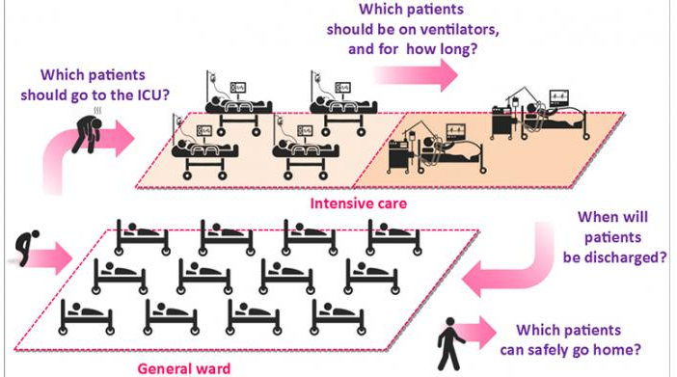
Pillar C Estimation of Severity
a mobile application for public (contacts) to self-regulate themselves and (ii) a platform for primary and secondary health care to perform their diagnosis and decisions providing more personalized criteria
Hospital
communication with patients
Front-end diagnosis: Provide a graphical interface for doctors to perform TRIAGE (START & SOFA)
notify of events
apply START &
SOFA
Interventions, plans,etc.
Analysis & modelling module: Perform analysis, characterize and predict risks, factors etc.
Central Repository
API with app: Provide an programmable interface for triage doctor to interact with platform
https://www.cam.ac.uk/research/news/progress-using-covid-19-patient-data-to-train-machine-learning-models-for-healthcare

Slide 18
Pillar C Estimation of Severity
Risk
of infection
Pollution
Baseline functional status
Geography
Seasonality
Life style (i.e. smoking, mobility, alcoholism)
Mental disorders or retarding
SOFA +
Likelihood of survival
Conformation to authorities
measurements
Underlined diseases
Occupation
Factors to be considered

Slide 19
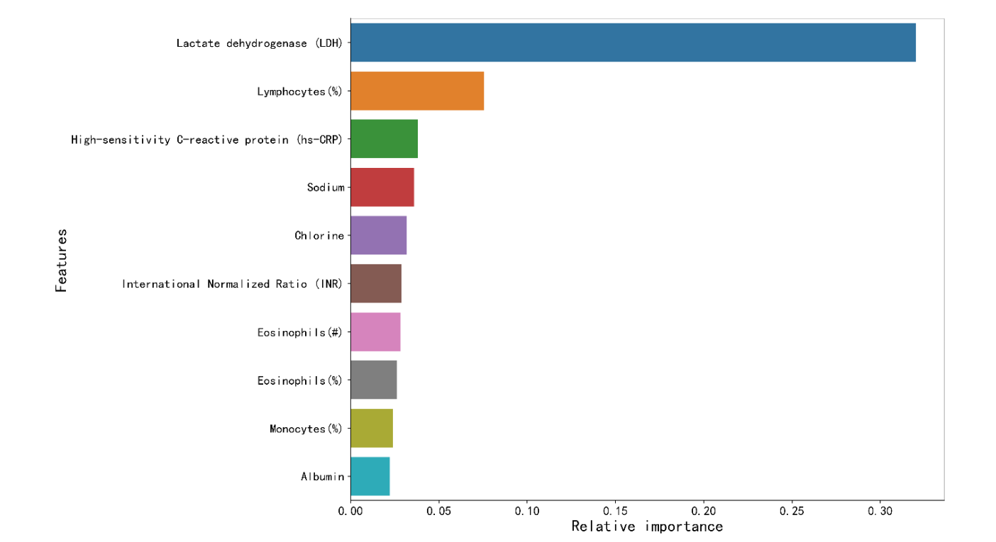
Pillar C Estimation of Severity – Indicative risk factors and biomarkers
L. Yan, H.-T. Zhang, J. Goncalves et al, A machine learning-based model for survival prediction in patients with severe COVID-19 infection,
https://doi.org/10.1101/2020.02.27.20028027 doi: medRxiv preprint

Slide 20
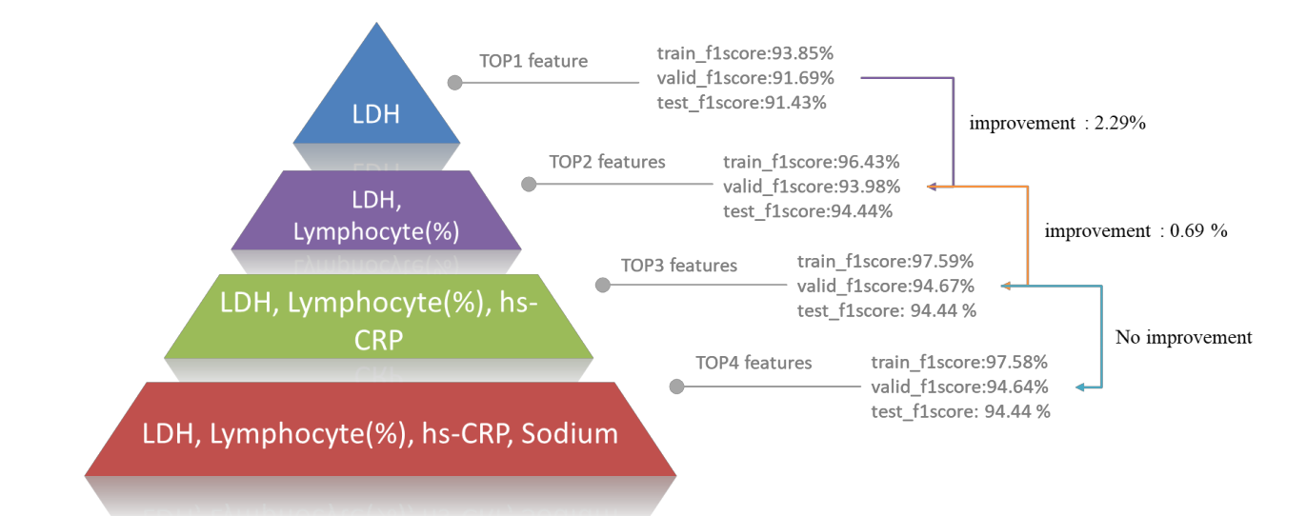
Pillar C Estimation of Severity – Indicative risk factors and biomarkers
L. Yan, H.-T. Zhang, J. Goncalves et al, A machine learning-based model for survival prediction in patients with severe COVID-19 infection,
https://doi.org/10.1101/2020.02.27.20028027 doi: medRxiv preprint

Slide 21
Pillar C Estimation of Severity – Indicative Decision Tree
L. Yan, H.-T. Zhang, J. Goncalves et al, A machine learning-based model for survival prediction in patients with severe COVID-19 infection,
https://doi.org/10.1101/2020.02.27.20028027 doi: medRxiv preprint

Slide 22

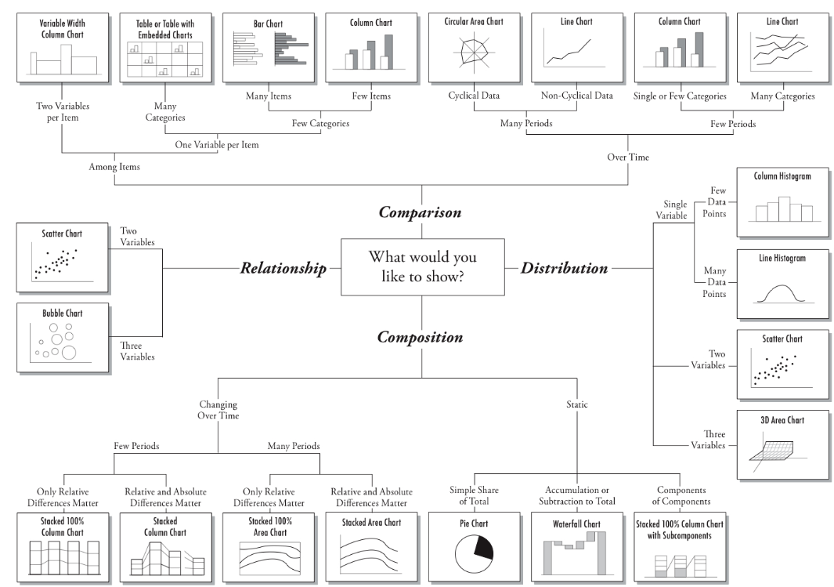
Horizontal Technologies - Machine Learning Methods & Visual Analytics

Slide 23
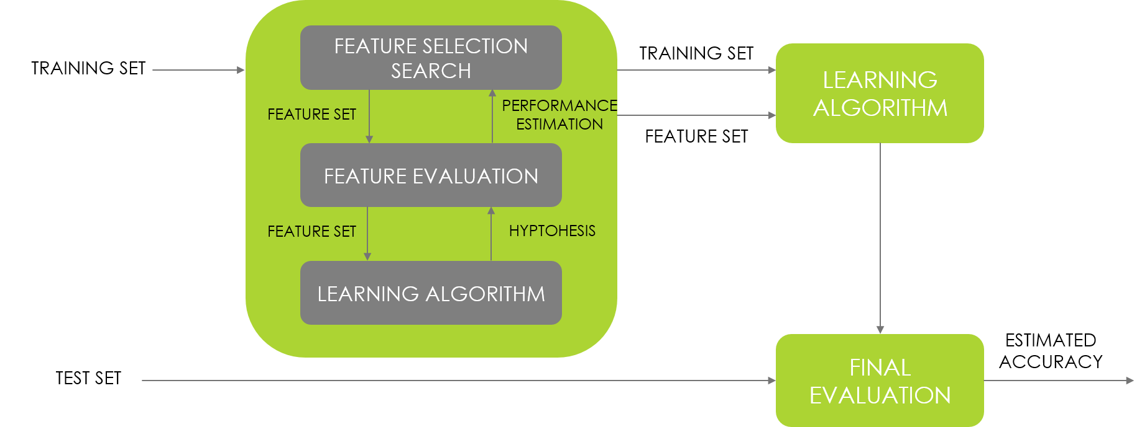
Horizontal Technologies – Machine Learning Methods
For the identification of risk factors and biomarkers of severity

Slide 24
Horizontal Technologies - Machine Learning Methods
Decision Trees
Bagging
Bootstrap aggregating
Ensemble meta-algorithm
Boosting
Error minimization from previous models
Gradient Boosting
Decision support tool using a tree-like model
Gradient descent algorithm to minimize errors
XGBoost is a high-performance machine learning algorithm that benefits from great interpretability potential due to its recursive tree-based decision system.

Slide 25
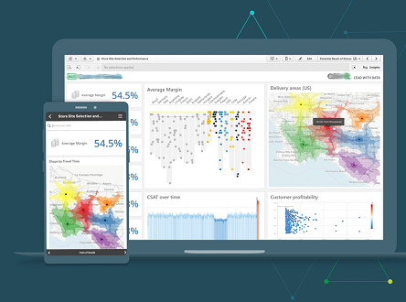
Horizontal Technologies – Visual Analytics
Use a mix of visuals to support and explain results.

Slide 26

Horizontal Technologies – Visual Analytics
Use a mix of visuals to support and explain results.

Slide 27
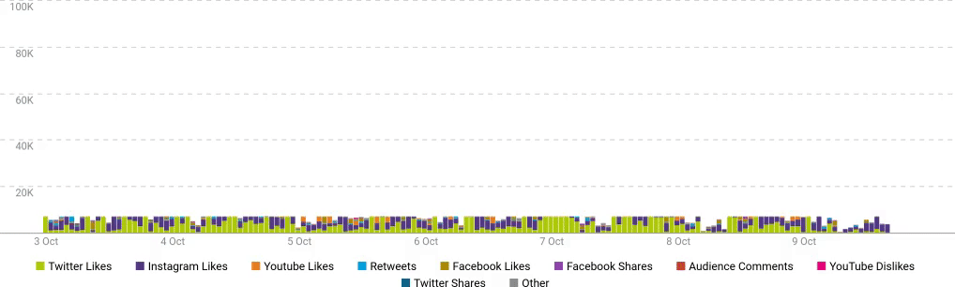
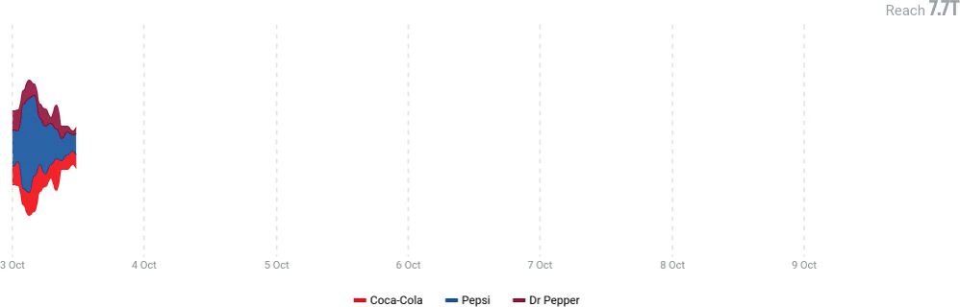
Horizontal Technologies – Visual Analytics
Use a mix of visuals to support and explain results.

Slide 28
Team
Principal Investigator
Panagiotis Vlamos, Professor, Bioinformatics and Human Electrophysiology Laboratory, Dept. of Informatics, Ionian University
Members
Aristidis Vrahatis, Researcher, Bioinformatics and Human Electrophysiology Laboratory, Dept. of Informatics, Ionian University
Themis Exarchos, Assistant Professor, Bioinformatics and Human Electrophysiology Laboratory, Dept. of Informatics, Ionian University
Panagiotis Kourouthanasis, Associate Professor, Dept. of Informatics, Ionian University
Phivos Mylonas, Associate Professor, Dept. of Informatics, Ionian University
Simos Kokkovos, Head Dept of Digital Health Services, Siemens Healthineers Greece
Dimitrios Niotis, Digital health services engineer, Siemens Healthineers Greece
Anastasios Ntouskas, Digital health services engineer, Siemens Healthineers Greece
Stella Geronikolou, Epidemiologist, Medical School, National and Kapodistrian University of Athens
George Chrousos, Professor, Medical School, National and Kapodistrian University of Athens

